Slide 1

Illicit Financial Flows Monitoring

Slide 2
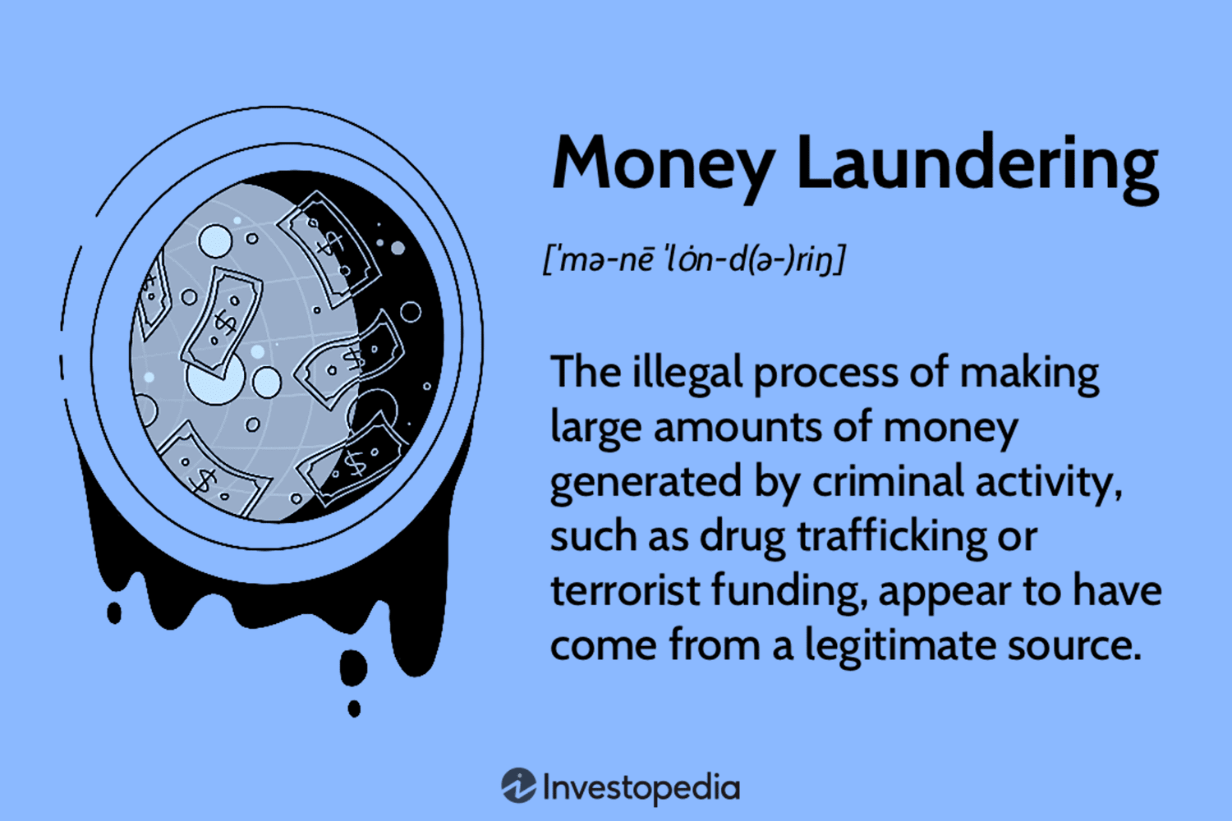
1. Executive Summary:
The Illicit Financial Flows Monitoring project aims to provide a comprehensive, data-driven approach to identifying, analyzing, and mitigating risks associated with illicit financial activities. By leveraging Power BI’s robust data visualization and analytics capabilities, the project empowers organizations to monitor financial transactions in real-time, detect suspicious activities, and ensure compliance with anti-money laundering (AML) regulations.

Slide 3
2. Problem Statement:
Background: Effective identification of Money laundering specific to Domestic & international fund transfers. The procedure will help to identify various ML trends followed by launderers according to their financial behaviour.
Objective: Develop ML (Money laundering ) detection model with respect to nature of transactions initiated
Scope: Primarily focusing on different Money laundering MO’s followed by various account holders . with the backup of current info , build a account triggering mechanism which would highlight high risk accounts prone to Money laundering.

Slide 4
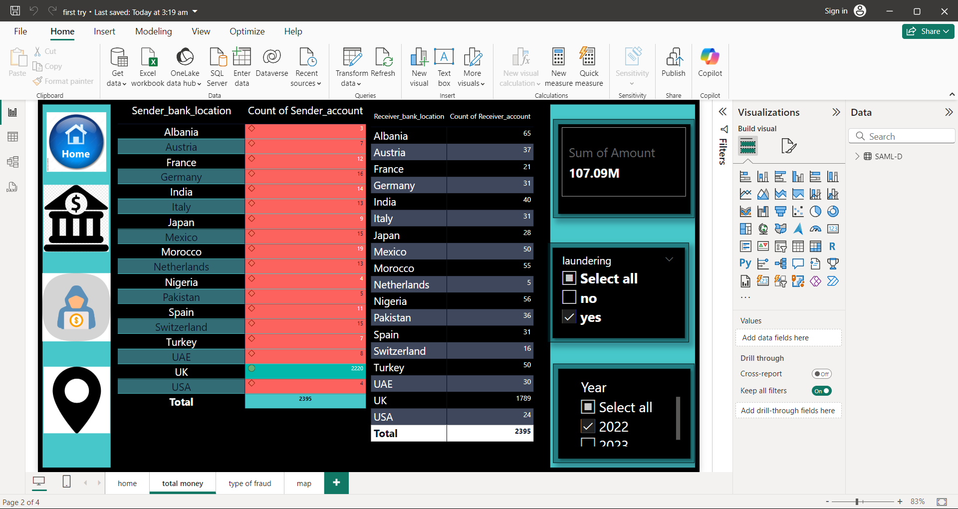

Slide 5
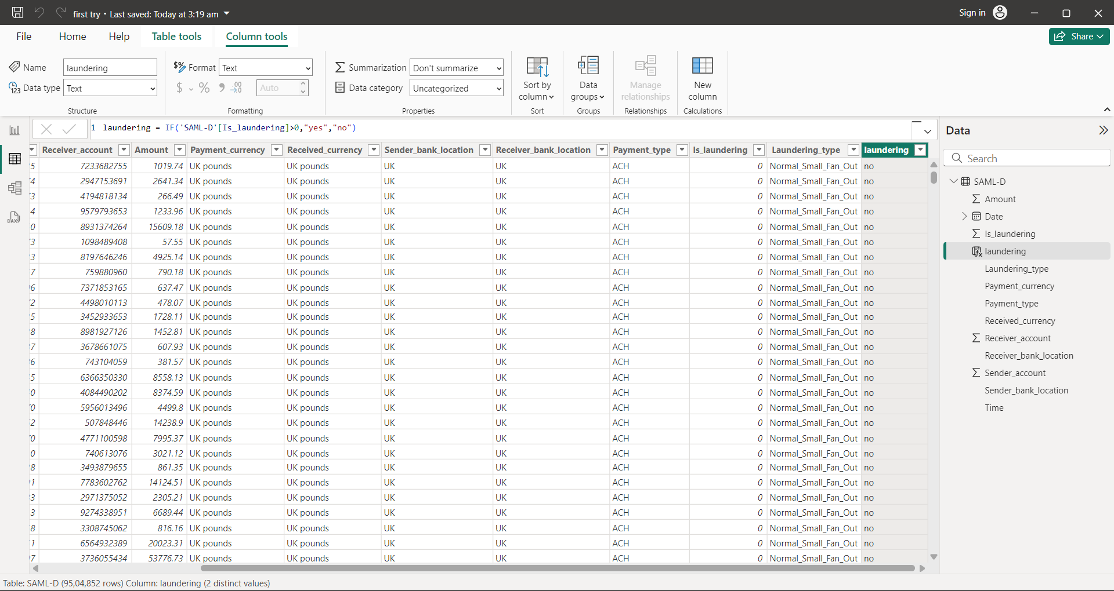
Data Integration and Transformation
ETL Process (Extract, Transform, Load): Extract data from diverse sources, clean and transform it into a standardized format suitable for analysis in Power BI.

Slide 6
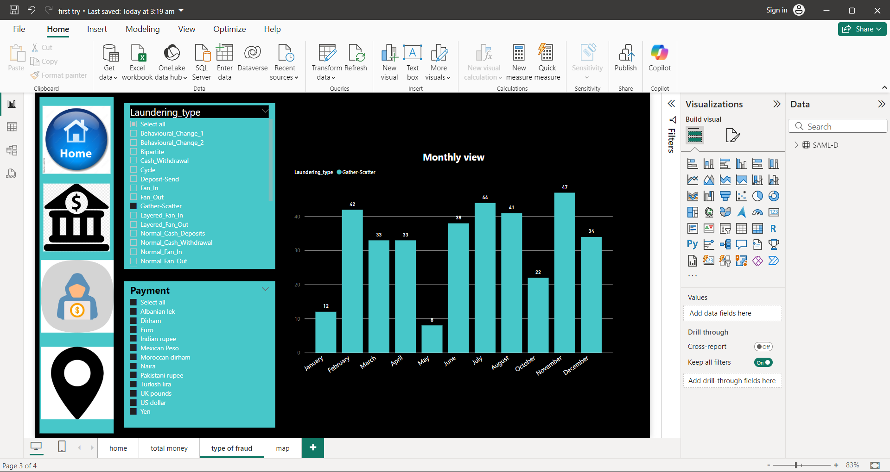
Visualization and Reporting
Dashboard Creation: Create intuitive Power BI dashboards Interactive Visuals: Use Power BI’s interactive features such as slicers, filters, and drilldowns

Slide 7
Outcomes
1. Interactive Dashboards
High-Level Overview: A dynamic dashboard that offers a summary of overall financial activity, highlighting potential illicit financial flows, risky transactions, and trends over time.
Geospatial Mapping: Visualizations that map transactions and entities to detect suspicious flows across geographic regions, helping to pinpoint high-risk areas
Transaction Monitoring: A live feed of transactions with filters for transaction type, amount, date, and risk profile, allowing users to drill down into suspicious activities.
2. Trend Analysis Reports
Historical Trends: Visual reports highlighting the growth or decline in illicit financial activities over time, showing trends such as an increase in suspicious transactions, or new patterns in money laundering techniques.

Slide 8
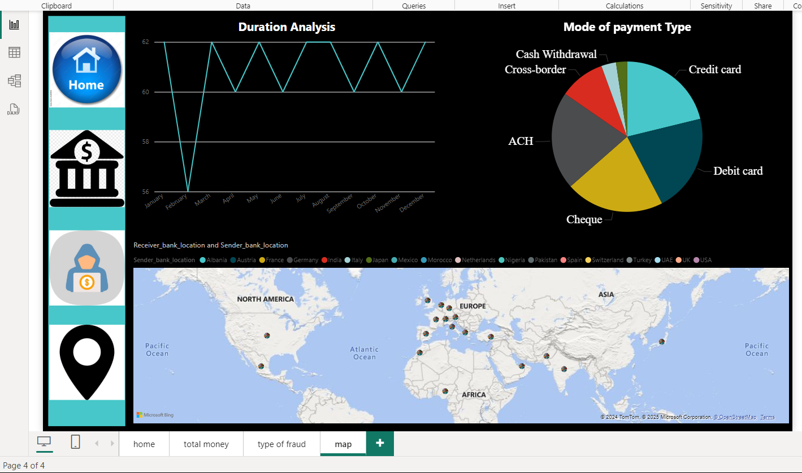

Slide 9
Conclusion
Illicit Financial Flows Monitoring is an essential component of safeguarding global financial systems from crimes such as money laundering, fraud, and terrorist financing. These illicit activities not only compromise economic stability but also pose significant risks to both financial institutions and regulatory bodies.
In conclusion, while the challenges of monitoring illicit financial flows are substantial, the benefits of effective detection systems—such as enhanced regulatory compliance, improved financial transparency, and reduced exposure to crime—are immense. By investing in cutting-edge technologies, fostering collaboration, and building a culture of continuous improvement, organizations can play a pivotal role in ensuring the integrity of the global financial system and preventing financial crime on a large scale.

Slide 10
